Slide 1


ELIXIR CAPITALS x tradebook
Eshaan Kumar & Abhay Singh
1st July-2023

Slide 2

AGENDA
About Elixir Capitals
Governance
​Business Model
Response to Tradebook

Slide 3
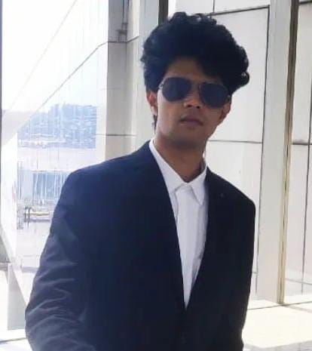
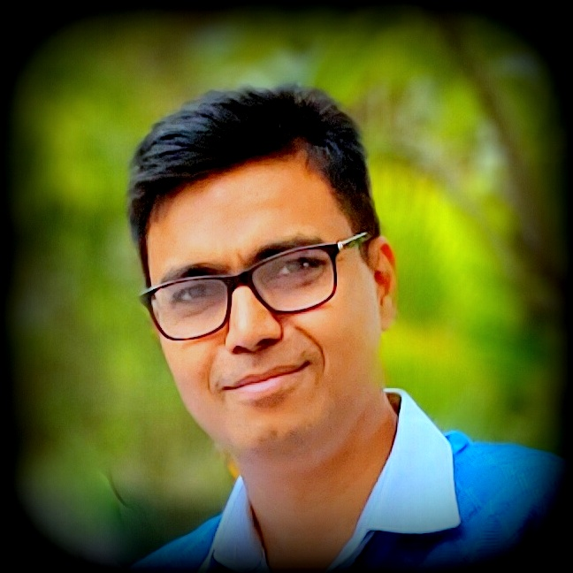
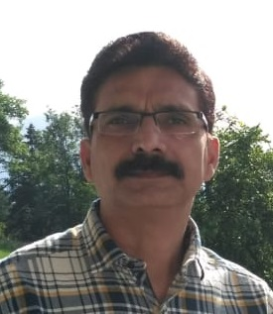
MEET OUR TEAM
Eshaan Kumar
Abhay Singh
Devendra Kumar
Director-Strategy
Director-Business Relations
Director-Logistics

Slide 4

ELIXIR’S MISSION
Grow clients’ investments by maximizing profits & manage losses using the best portfolio management strategies

Slide 5

Governance
The monthly transaction report (PnL) will be shared with all the customers
AUM & Overall Profit will be shared, customers can calculate their own profit based on their stake in the AUM. Single Demat/Current account will be used for all trades
Elixir will be available for query resolution & customer support
All customer data and investment details are confidential
The strategy utilized by Elixir Capitals will remain CONFIDENTIAL

Slide 6

Business Model
PERIOD
It is recommended to maintain the capital with us for a period of 1 Year to notice the best results
PROFIT SHARING
Up to 1st % monthly profit will be given to the customer, Profits in excess of 1% monthly will be equally divided
Ex 5% monthly profit- Client will receive 1+ half of remainder = 3%
Elixir will receive the rest = 2%
Settlement
The profits will be settled in 3 month’s period
If the client wishes to keep profits with Elixir then the effect of compounding will further increase returns
Exit Load
If the client wishes to withdraw the capital [partially or fully] before 3 months, then 1% of the amount withdrawn will be deducted
Notice Period & Management Fees
The client needs to provide a notice period of a minimum of 1 week
0.02% Monthly Maintenance Fees will be applicable on AUM

Slide 7
RESPONSE
TO
Tradebook

Slide 8

ELIXIR’s Response to tradebook
We agree to profit sharing based on the previously discussed model
Tradebook will be responsible for Fundraising while
Elixir will be responsible for the growth of the fund
After a thorough consultation with multiple authorities, it was identified that the cost of licensing and branding can be avoided up at the initial stage of development
We will work on licensing and branding when a significant AUM has been accomplished

Slide 9

ELIXIR’s Response to tradebook
We understand that Tradebook is driven by an equally strong desire to start this project ASAP, Elixir is committed to expediting the process of initiation

Slide 10
THANK YOU
Abhay Singh
abhayk007@gmail.com

